Slide 1
Talent Development Web App

Slide 2
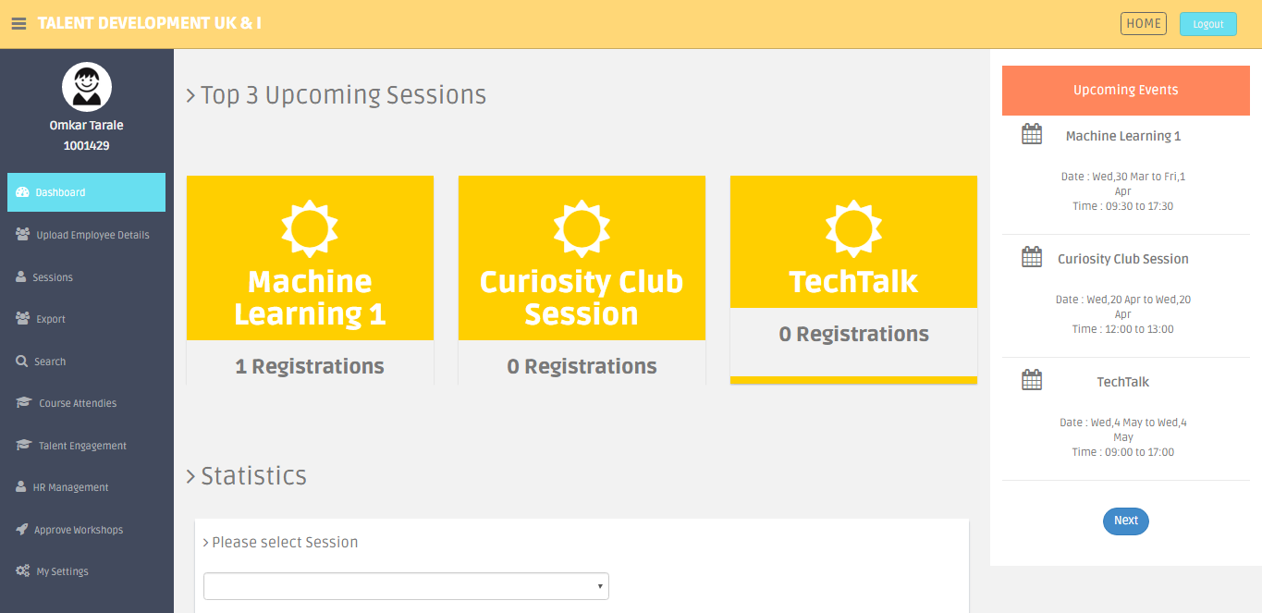
Admin Dashboard

Slide 3
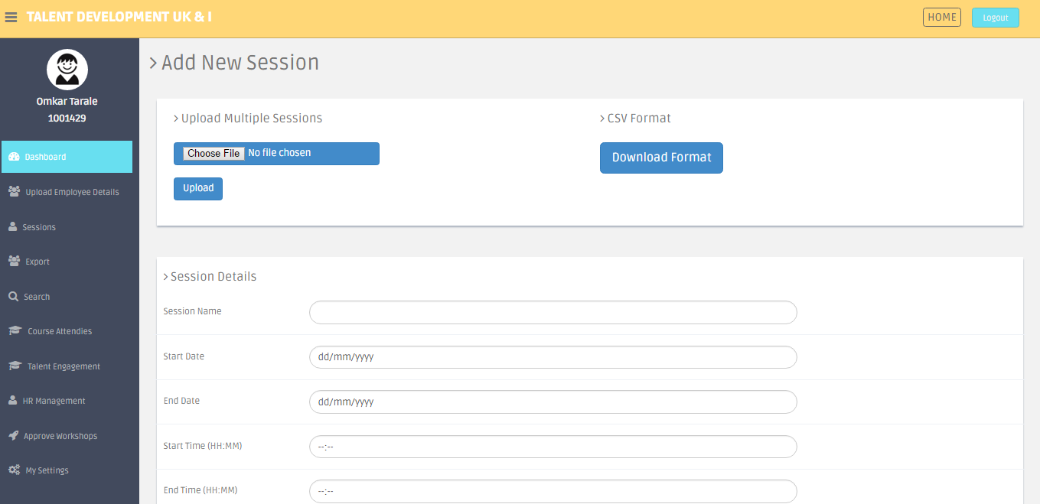
Session Management
Add/Upload Session Details

Slide 4
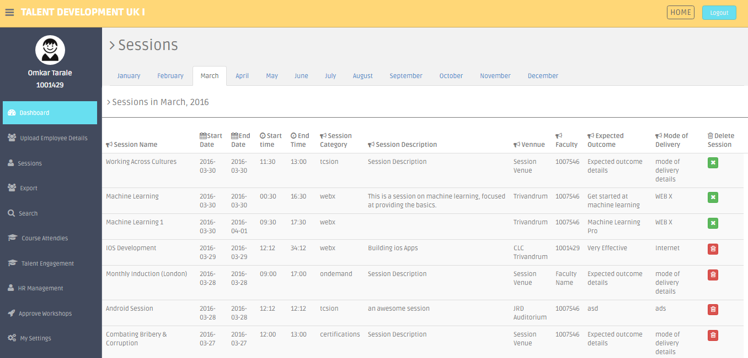
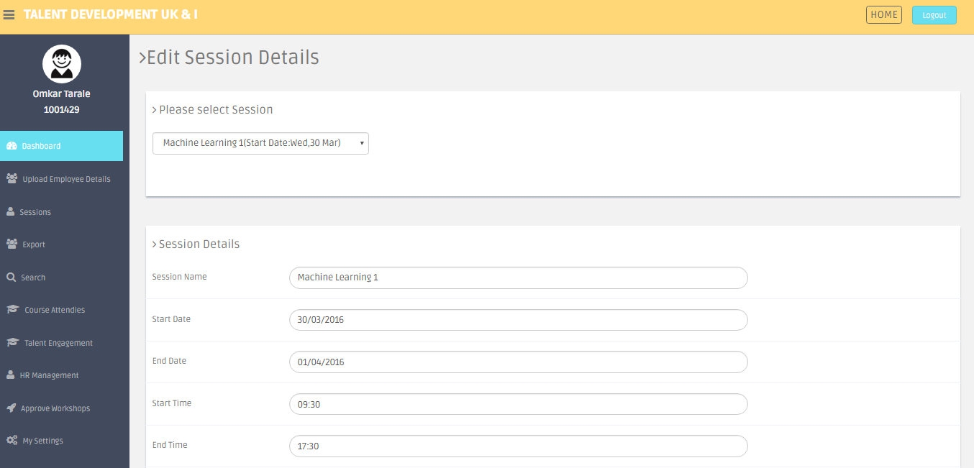
Edit Session Details
View/Delete Session Details

Slide 5
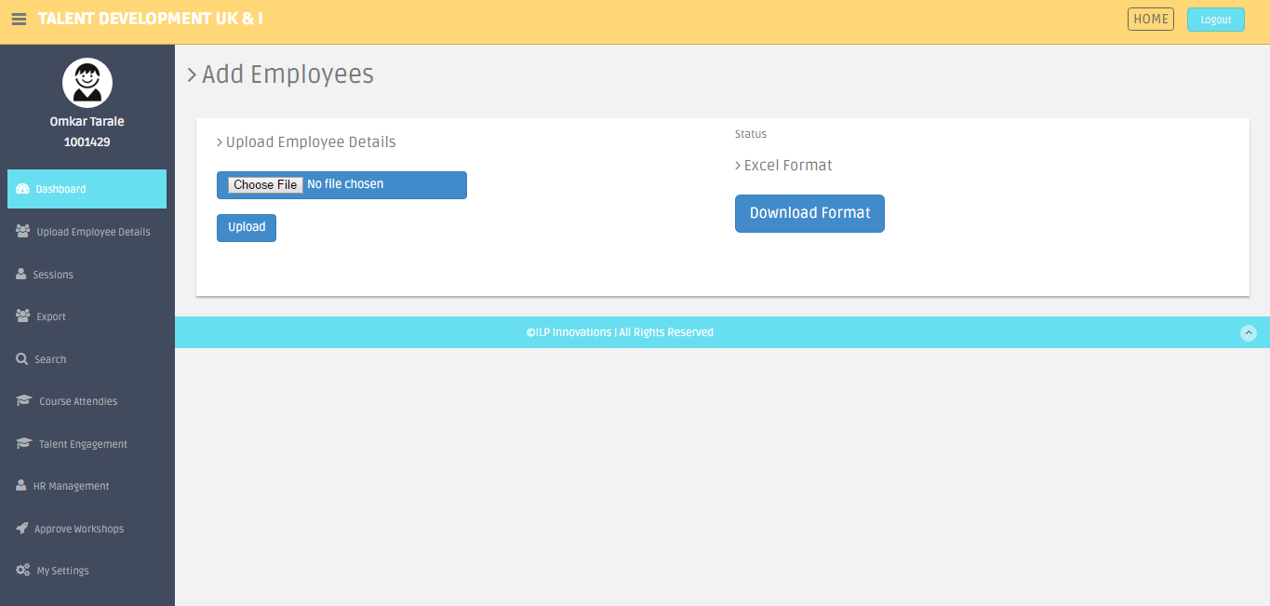
Upload Employee Details

Slide 6
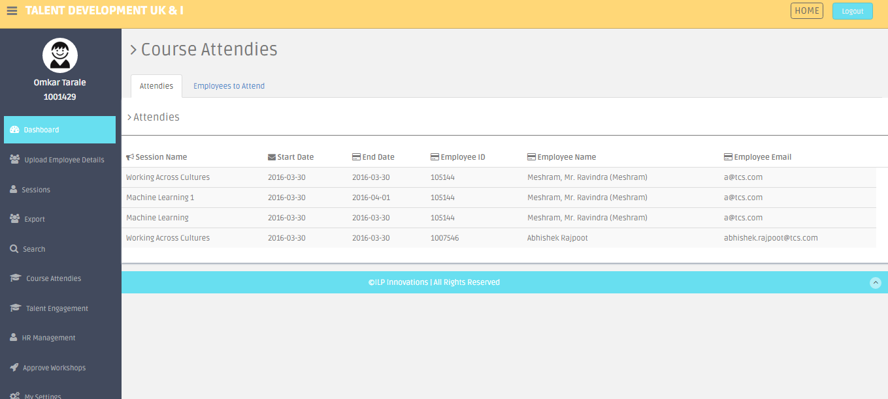
Course Attendees

Slide 7
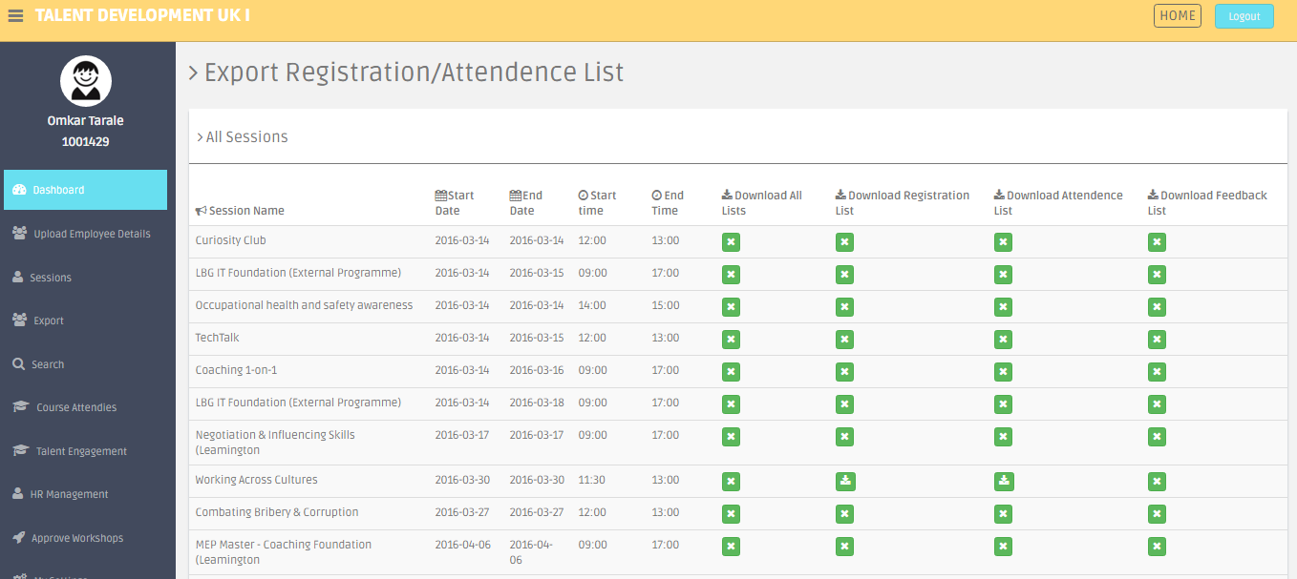
Export to Excel
Feedbacks, Registrations, Attendies

Slide 8
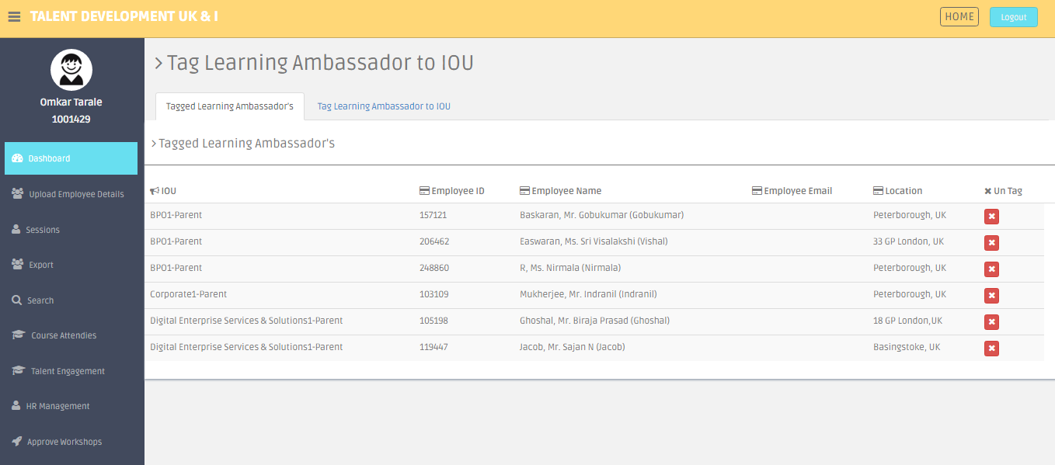
Tag Learning Ambassador

Slide 9
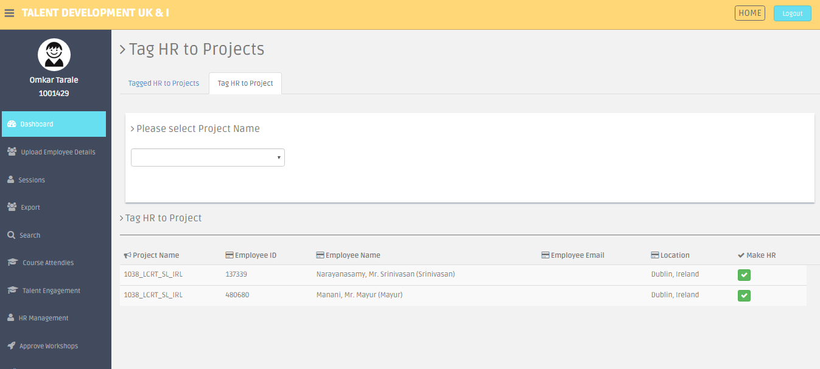
Tag HR to Projects

Slide 10
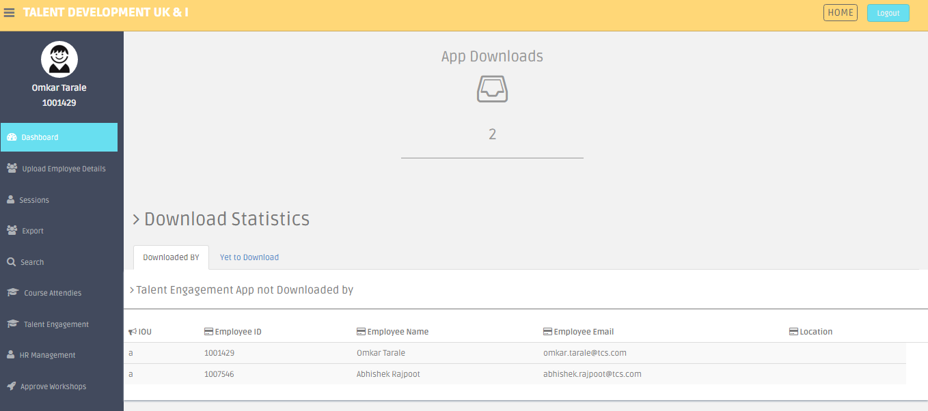
Talent Engagement

Slide 11
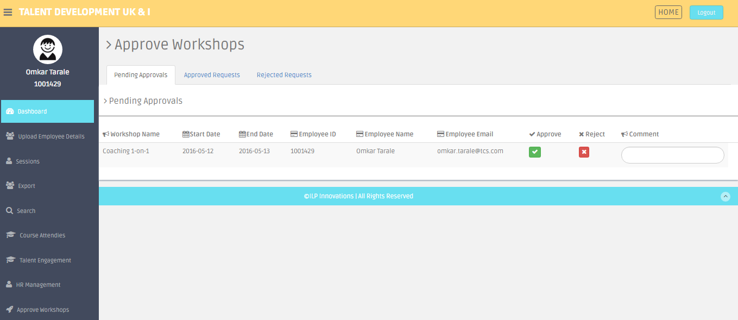
Approve Workshops

Slide 12
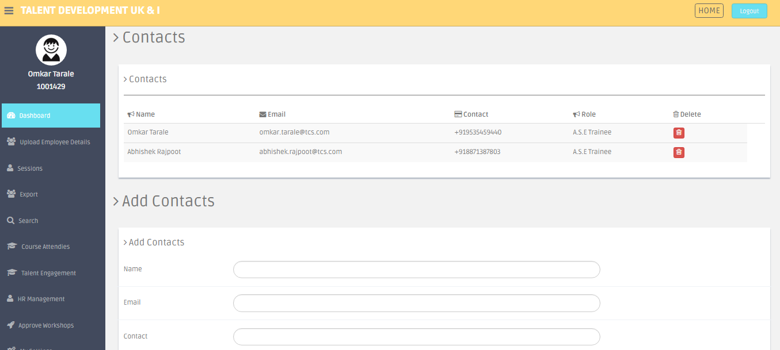
Add Contacts
The contacts added here are visible in Android Application

Slide 13
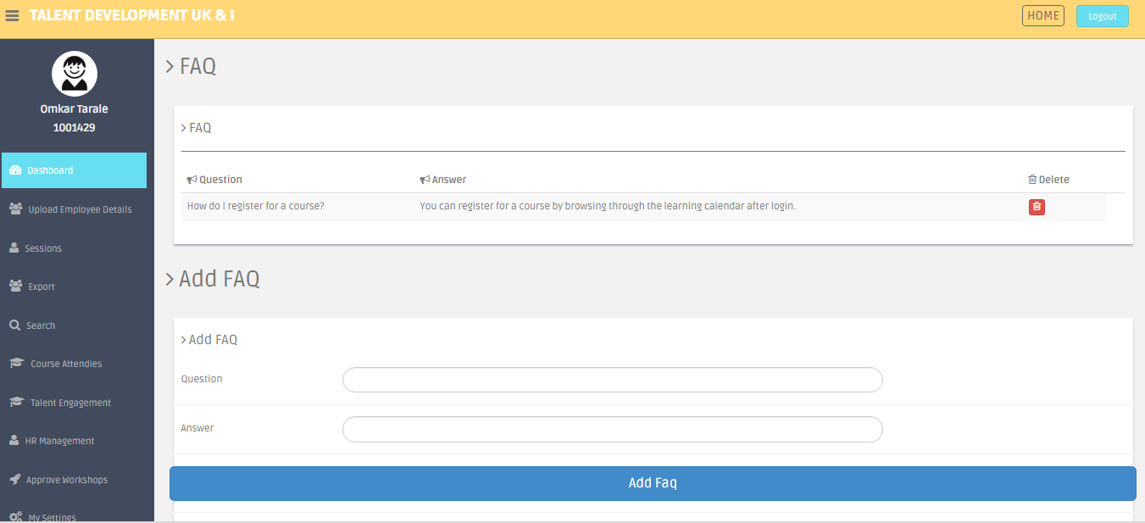
Add FAQ’s
The FAQ’s added here are visible in Android Application

Slide 14
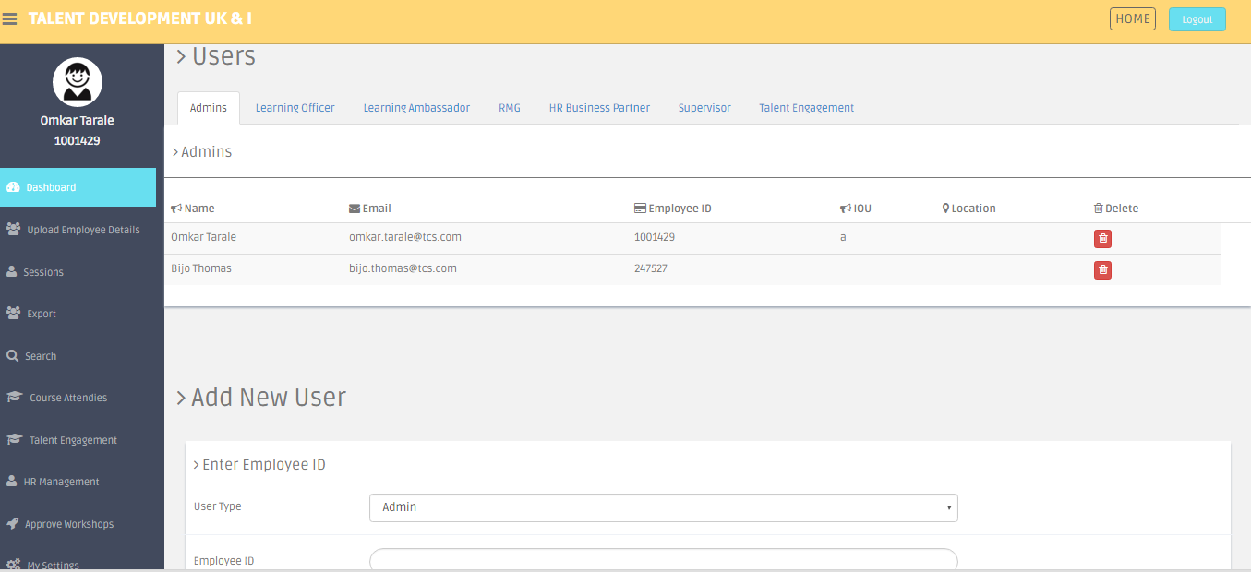
Manage Roles

